Slide 1

Local Elections in England – What is the message?
by
Oyeleke Olaoye
August 9, 2019

Slide 2

STUDY BACKGROUND & OBJECTIVES

Slide 3

BACKGROUND OF THE STUDY
England held local elections on 2nd of May, 2019. The two main parties suffered losses while minor parties made significant gains.
Our interest is in describing the characteristics of the local authorities where the significant change in hand happened.

Slide 4
RESEARCH QUESTIONS
where the Conservatives lost a large proportion of the seats up for election?
where Labour lost a large proportion of the seats up for election?
in which the Liberal Democrats / Greens / Independents made the largest gains?
What are the characteristics of the local authorities

Slide 5
DESCRIPTION OF THE DATA

Slide 6
England Local Election 2019 Dataset
248 observations
41 incomplete cases
Five (5) response variables
Proportion change for (Conservative, Labour, LibDem, Independents, Greens)
Eleven (11) explanatory variables
Proportion of people in social grade (AB, C1, C2, DE).
Vote Share in the 2017 General Election for (Conservative, Labour, LibDem, UKIP, Green)
Leave EU Vote Share in 2016 referendum.
Region of Local Authority
NOTE.
We split our dataset into five, one for each party, for the purpose of this presentation, we focus on the results for the Conservative dataframe , the same approach was adopted for the rest parties.

Slide 7
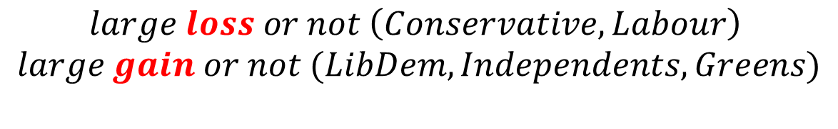
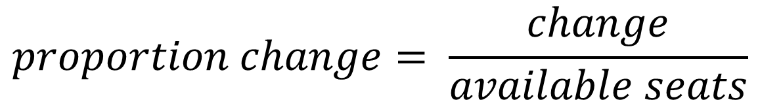
VARIABLE TRANSFORMATION
$$proportion change= \frac{change}{available seats}$$
binary change
$$large loss or not \left(Conservative, Labour\right)$$
$$large gain or not (LibDem, Independents, Greens)$$

Slide 8
INITIAL INSIGHTS

Slide 9
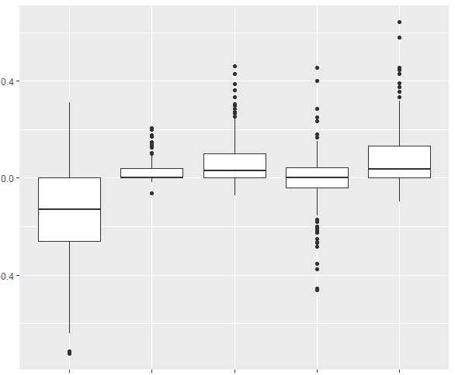


INITIAL INSIGHTS
$$+$$
Proportion Change
$$−$$
Conservative
Green
Independents
Labour
Liberal Democrats
Fig 1. Snapshot of the election result.

Slide 10
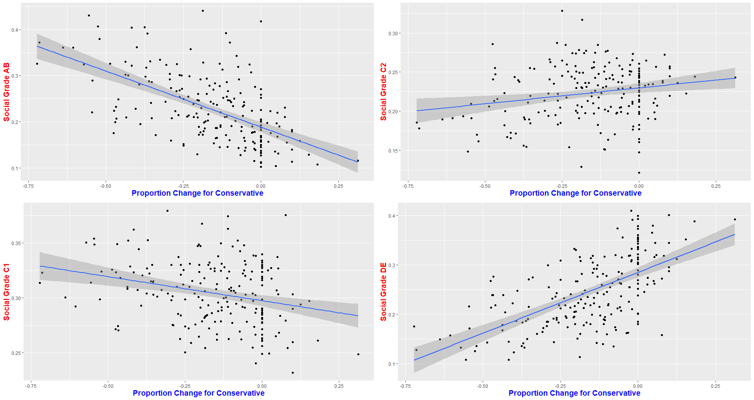
INITIAL INSIGHTS
Fig 2. Scatterplot indicating a class divide in choice of support for Conservative where AB & C1 had a negative relationship with Conservative, C2 & DE had a positive relationship for Conservative.

Slide 11
METHOD: BINARY LOGISTIC REGRESSION

Slide 12
Why logistic regression?
Models a binary output.
Our response is not normally distributed and no suitable transformation was found.
Key Assumptions
Response variable is binary
Independent observations
Limitations
Multicollinearity
Low sample size

Slide 13
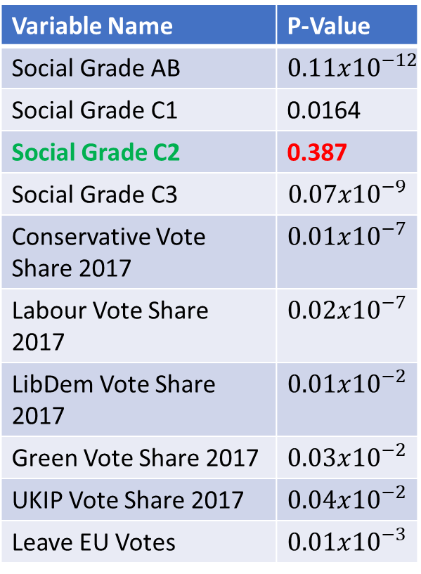
VARIABLE SCREENING
Variable Name | P-Value
Social Grade AB | $$0.11x{10}^{−12}$$
Social Grade C1 | 0.0164
Social Grade C2 | 0.387
Social Grade C3 | $$0.07x{10}^{−9}$$
Conservative Vote Share 2017 | $$0.01x{10}^{−7}$$
Labour Vote Share 2017 | $$0.02x{10}^{−7}$$
LibDem Vote Share 2017 | $$0.01x{10}^{−2}$$
Green Vote Share 2017 | $$0.03x{10}^{−2}$$
UKIP Vote Share 2017 | $$0.04x{10}^{−2}$$
Leave EU Votes | $$0.01x{10}^{−3}$$
Table 1. A univariate analysis using a p-value threshold of 0.25 to select variables of clinical importance as recommended by Hosmer & Lemeshow (2000).

Slide 14
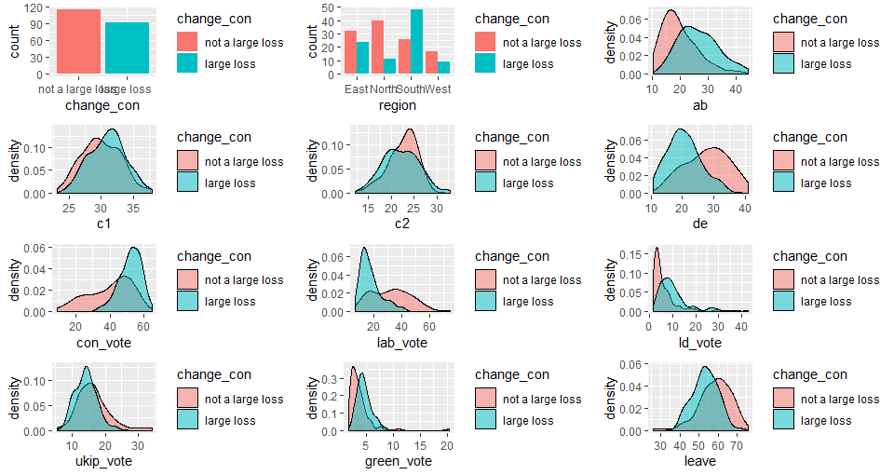
VARIABLE SCREENING
a
b
c
d
e
f
g
h
i
j
k
l
Fig 3. Barplots and Density plots.

Slide 15
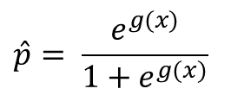
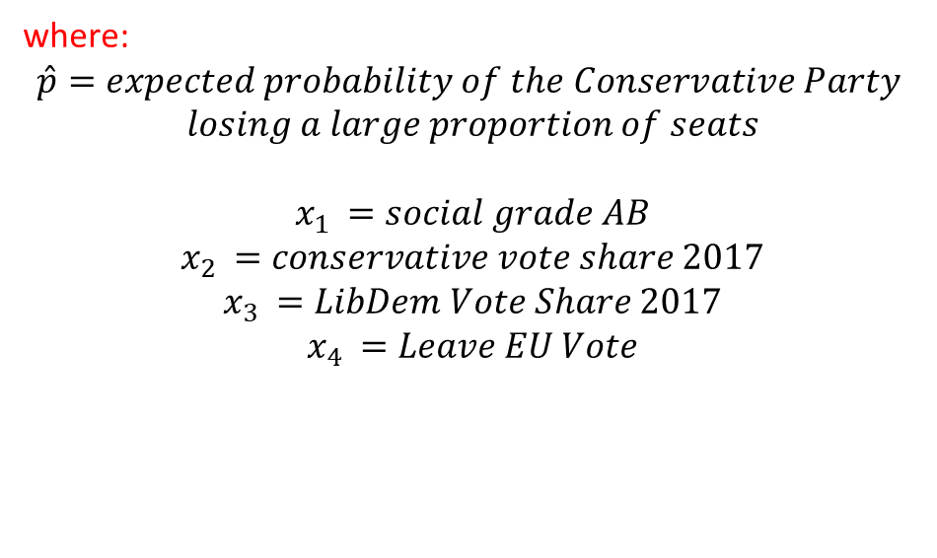

MODEL FOR CONSERVATIVE LOSS
$logit(\hat{p})=\ln\left(\frac{\hat{p}}{1−\hat{p}}\right)=$ $g(x)$
i
$$\hat{p}= \frac{e^{g(x)}}{1+e^{g(x)}}$$
ii
$$g\left(x\right)=β_{0}+ β_{1}x_{1}+β_{2}x_{2}+β_{3}x_{3}+β_{4}x_{4}$$
iii
where:
$$\hat{p}=expected probability of the Conservative Party$$
$$losing a large proportion of seats$$
$$x_{1 }=social grade AB$$
$$x_{2 }=conservative vote share 2017$$
$$x_{3 }=LibDem Vote Share 2017$$
$$x_{4 }=Leave EU Vote$$

Slide 16
RESULT FOR CONSERVATIVE LOSS
Variable Name | Coeff | Std. Error | OR (95% CI) | P-Value
Intercept | 3.85 | 3.3 | - | 0.25
Social Grade AB | -0.18 | 0.07 | 0.83 (0.71, 0.95) | <0.05
Conservative Vote Share 2017 | 0.22 | 0.04 | 1.24 (1.16, 1.36) | <0.05
LibDem Vote Share 2017 | 0.08 | 0.03 | 1.09 (1.04, 1.16) | <0.05
Leave EU Vote | -0.19 | 0.06 | 0.82 (0.73, 0.91) | <0.05

Slide 17
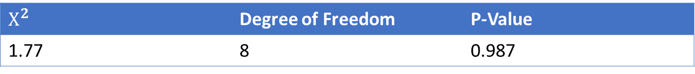
ASSESSMENT OF MODEL FIT
HOSMER-LEMESHOW TEST FOR GOODNESS OF FIT
$$H_{O}:the model is a good fit to the data$$
$$H_{1}:the model is not a good fit to the data$$
RESULT
$$Χ^{2}$$ | Degree of Freedom | P-Value
1.77 | 8 | 0.987
Conclusion
As p-value > 0.05, we do not reject the null hypothesis at 5% level of significance and conclude that there is no evidence of lack of fit for the specified model.

Slide 18
ADVANCED ANALYSIS PLAN

Slide 19
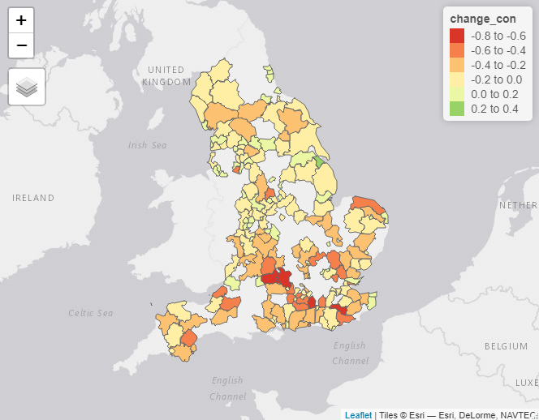
AREAL UNIT DATA
This is an areal unit data where the domain (England) is split into n non-overlapping units.
We suspect spatial autocorrelation.

Slide 20
QUESTIONS OF INTEREST
What is the spatial pattern in the data?
Does the data contain spatial autocorrelation or are the units independent?
Can we remove the spatial random effect and estimate a spatially smooth mean function for the data?

Slide 21
Thank you for listening!

Slide 22
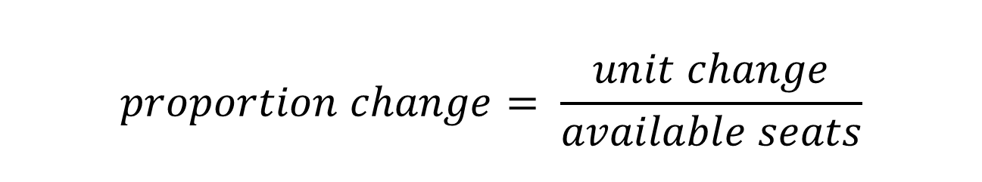
DATA TRANSFORMATION
$$proportion change= \frac{unit change}{available seats}$$
Why did we create this variable?
Relevance in answering our questions of interest
To account for differing number of seats each council put up for election

